Slide 1
AIDA-Project
Telekom Customer Churn Prediction
M. Sauer
GIT, data models,
feature selection
J. E. Dietert
EDA, classic fit, NN
T. Habermann
NN models, KNN

Slide 2

Definition
Churn rate (sometimes called attrition rate), in its broadest sense, is a measure of the number of individuals or items moving out of a collective group over a specific period. It is one of two primary factors that determine the steady-state level of customers a business will support.
source: wikipedia.org
Sauer

Slide 3

Project And Objectives
Knowing the intent of a customer to leave, is a highly valuable information. It can be used for prevention, by providing specific offers to these.
Objective of this project, is to create a machine learning algorithm, which is able to provide this knowledge based on everyday data of a telecommunication company.
Sauer

Slide 4
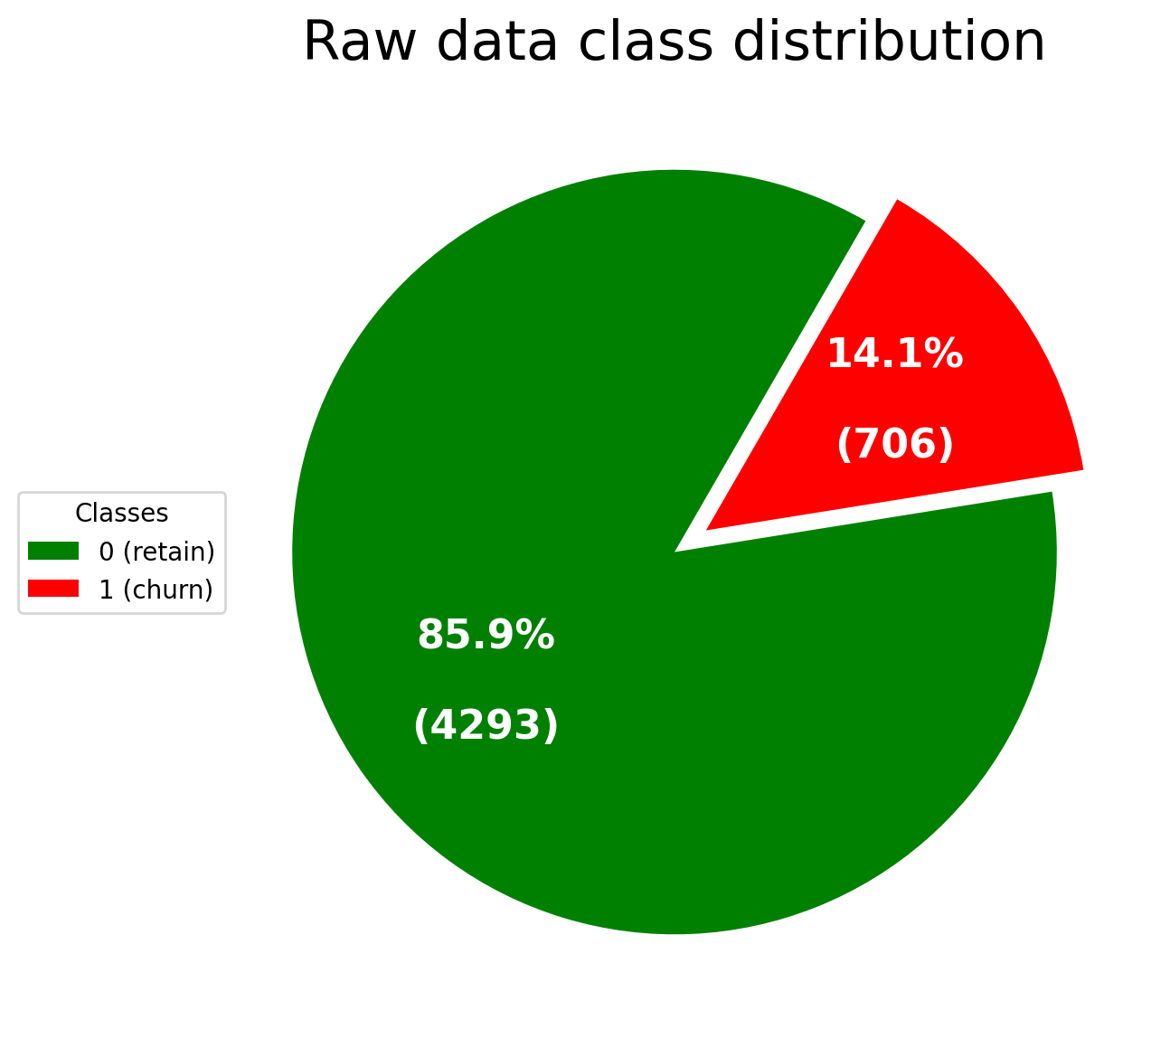
Knowing the data
Set of 5000 customers
21 features about each of them (including a binary value if they do churn or not)
1/7 churn customers, 6/7 no churn customers
class (target) | state | account_length | total_day_minutes | total_eve_minutes | total_night_minutes | total_intl_minutes
international_plan | area_code | number_vmail_ messages | total_day_calls | total_eve_calls | total_night_calls | total_intl_calls
voice_mail_plan | phone_number | number_customer_service_calls | total_day_charge | total_eve_charge | total_night_charge | total_intl_charge
Sauer

Slide 5
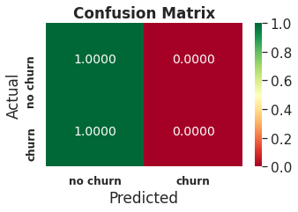
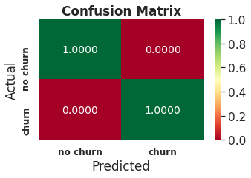
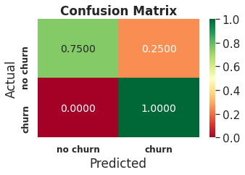
Metrics...Metrics...Metrics
The given task is a binary classification
Since we have an imbalanced class distribution accuracy is not the optimal metric. E.g. if a model would predict always 0 (no churn), we get approx. 0.86 accuracy but would totally fail to predict churns
It is necessary to have a high recall value i.e. to have nearly all churners in the set of customers identified for potential churn
But increasing number of retaining customers seen as churners by mistake makes it necessary to monitor precision
Constant 0 prediction but already 0.86 accuracy
➡
Raise recall
!
Habermann
Monitor precision

Slide 6
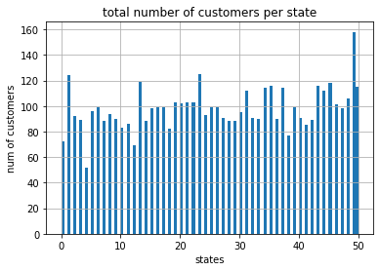
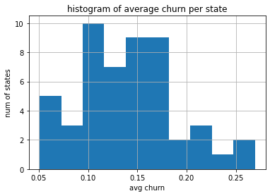
Data Inspection
distribution of #customers per (US)state: 50...125
average churn rate per (US) state: 5%...27%
Dietert

Slide 7
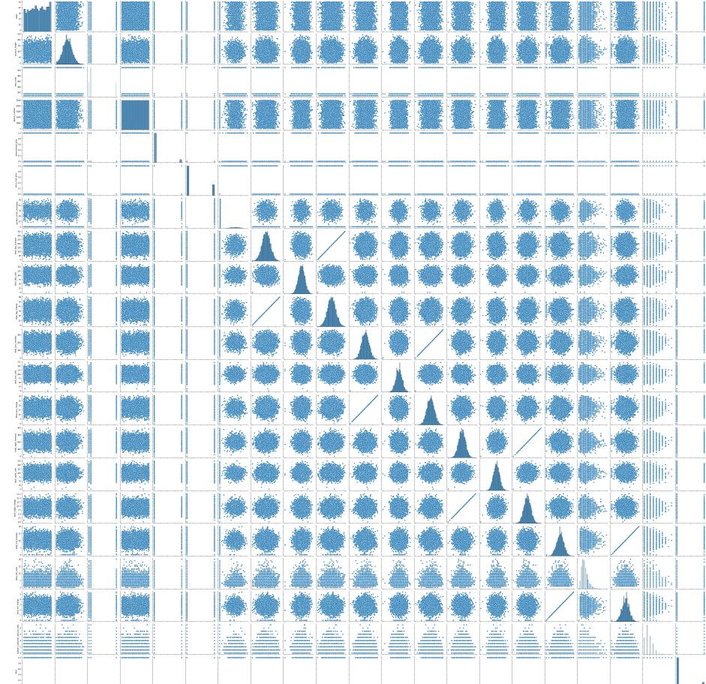
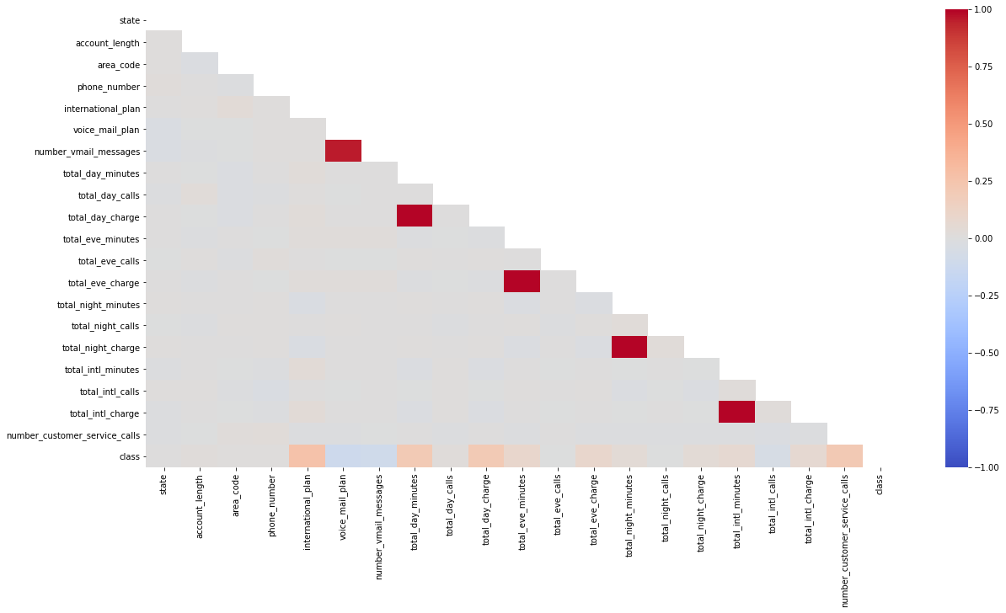
Data Inspection: eliminate correlations
pairplot of dependencies
correlation matrix
Dietert

Slide 8
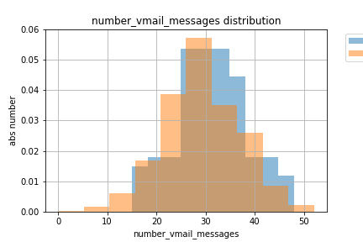
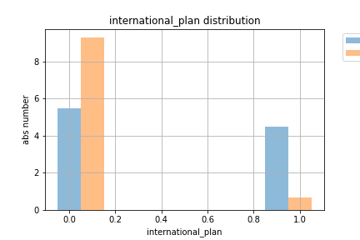
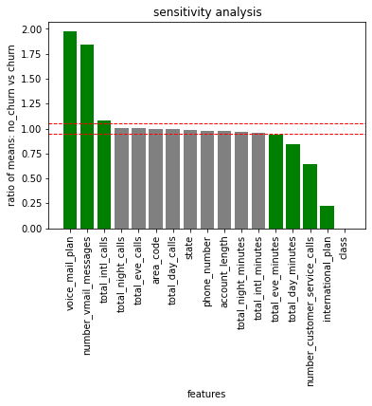
Data Preprocessing
#vmail_messages <= 30: true: no churn
#vmail_messages <= 30: false: churn
customers without international plan churn less, which might come from some misalignment of international charges.
International charges per minute (27ct/min) do not differ for customers with or without international plan
grouping according to class churn
build the ratio of feature means:
mean (no_churn) / mean (churn)
Dietert
features with high effects > 1.05 or < 0.95 (as green), while other features have similar averages in their distributions

Slide 9
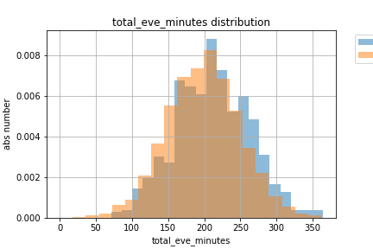
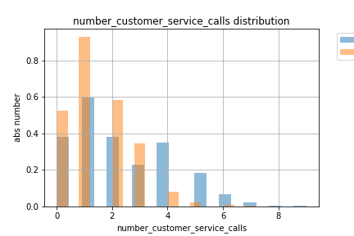
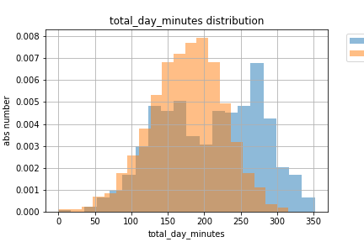
Data Preprocessing:
total day minutes <= 265.4
This decision is valid since also seen in the statistics of no_churn vs churn customers.
There seem two sub-sets of churners in their day-minutes.
total eve minutes <= 168.35
This decision is valid since also seen in the statistics of no_churn vs churn customers.
number customer calls <= 3.5
This decision is valid since also seen in the statistics of no_churn vs churn customers.
If a customer calls less than 3.5 times the hotline to complain, they could be identified as “happy”, so they stay.
Dietert

Slide 10
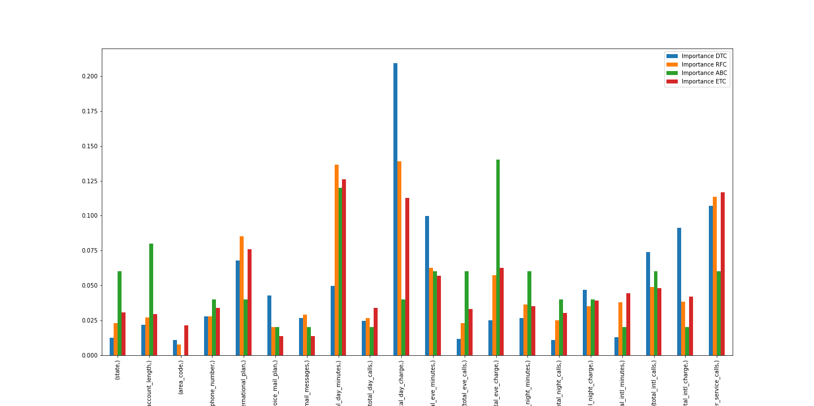
Feature Selection:
Feature Importance Comparision
for different Classifiers
Descission Tree Classifier (DTC) | Random Forest Classifier (RFC)
Extra Trees Classifier (ETC) | Ada Boost Classifier (ABC)
Sauer

Slide 11
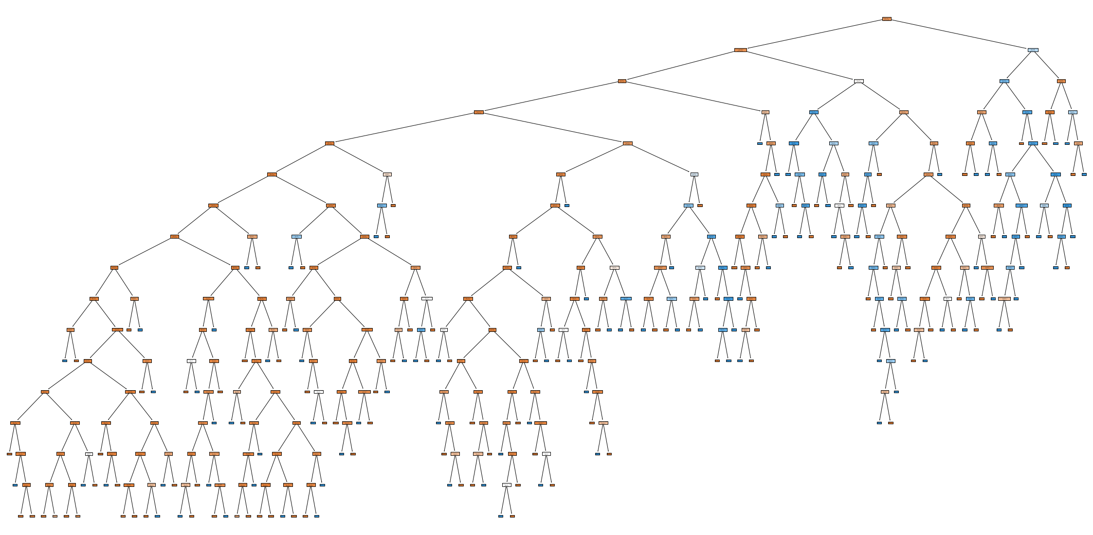
Standard classifiers: Decision Tree with best results
Standard classifier with individual parameterization:
logistic regression, sigmoid
k-Nearest Neighbour
Decision Tree
Random Forest
Multinomial Bayes
Gradient Boost
XGBoost
SVC
Dietert

Slide 12
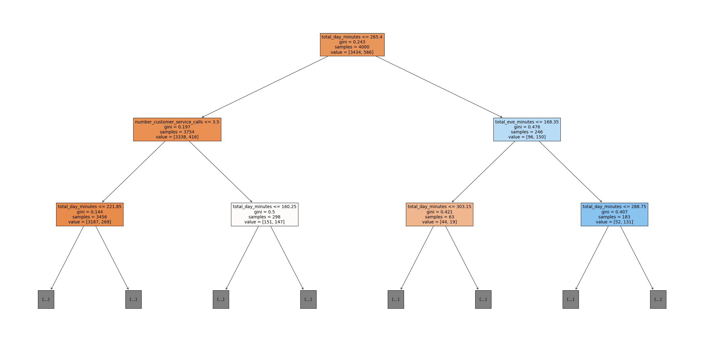
DT with reasonable decisions backed by statistics
day minutes
Dietert

Slide 13
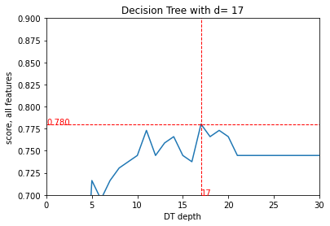
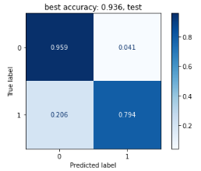
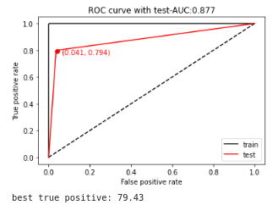
Classification result
optimal
The hyperparameter tuning of the DT classifier comes up with a degree of 17, slightly higher than the input feature dimension of 13.
The classifier on test set leads to
accuracy of 93.6%
true positive rate of 79.4%
~20% (28) were classified as no-churners despite they were churned customers.
869* 4%= 35 customers are misclassified as potential churners
Alternative visualization as ROC plot with the ideal target prediction as black line with the top-most left corner as the ideal point.
The area below the curve is 0.877 which is close to optimal value 1.0, compared to the poor 0.5 as dice-solution
Dietert

Slide 14
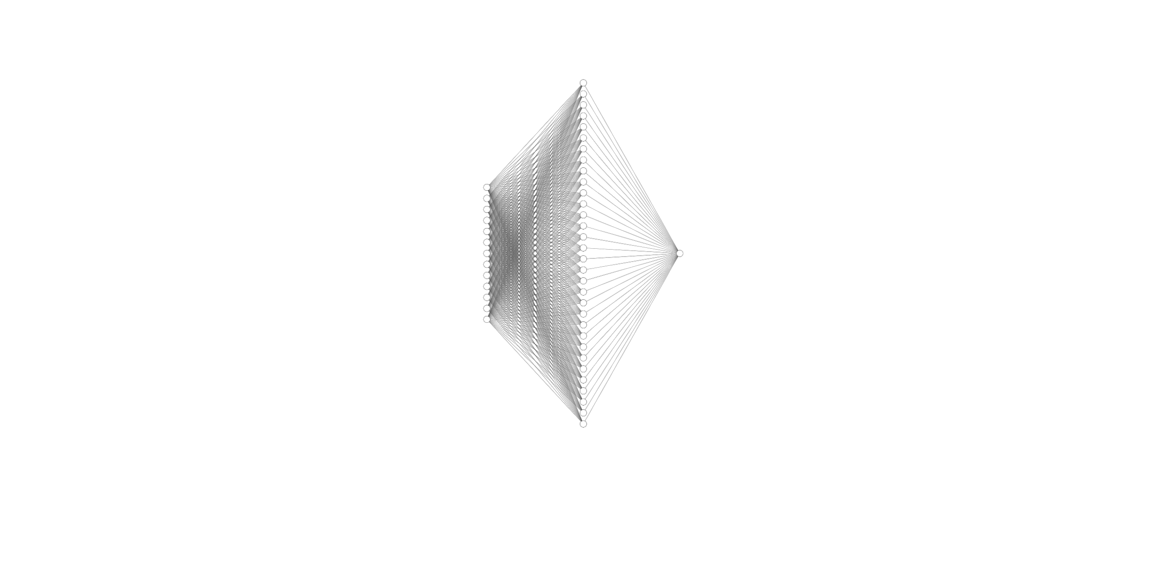
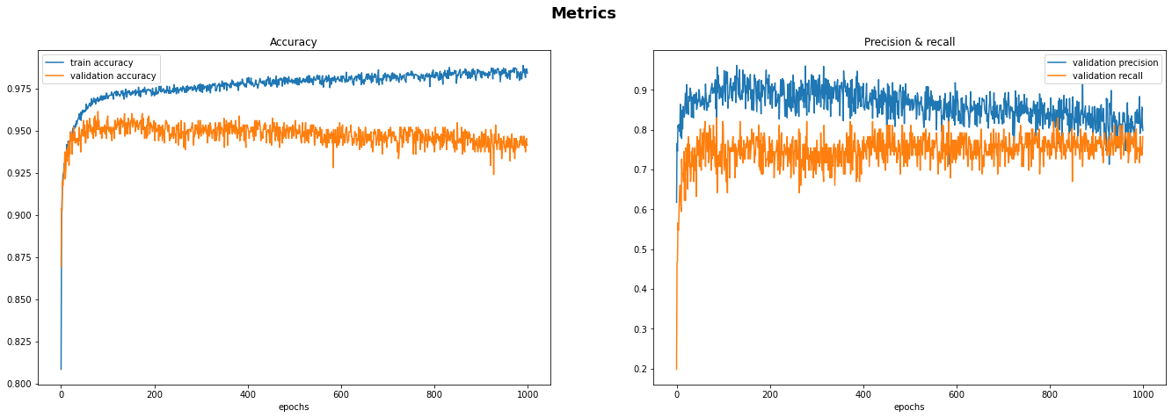
Simple Neuronal Network
Feed forward neural network with one hidden layer of 32 neurons (activation relu) and a single output (activation sigmoid)
Accuracy reaches up to 95% and recall and precision converge at approx. 80%
Habermann

Slide 15
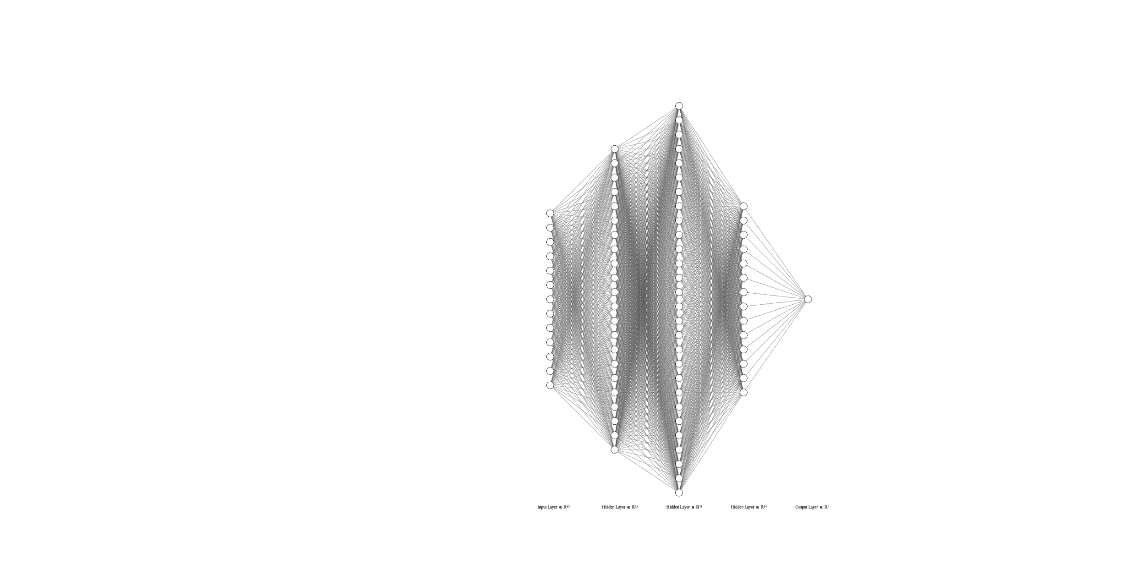
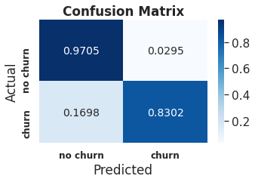
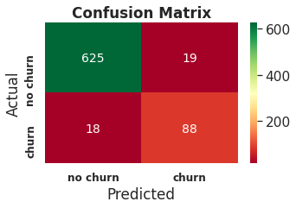
Multiple Hidden Layer Neuronal Network
Performance for different hidden layer sizes and more hidden layers with models chosen by different metrics:
An input-128-32-128-1 fully connected neural network with best recall outperforms the decision tree classifier for churn prediction
hidden layer neurons | Model taken with best parameter | Accuracy | 0 Precision | 0 Recall | 1 Precision | 1 Recall
[16] | Loss | 0.952000 | 0.963415 | 0.981366 | 0.872340 | 0.773585
[16] | Accuracy | 0.954667 | 0.966361 | 0.981366 | 0.875000 | 0.792453
[32] | Accuracy | 0.953333 | 0.963470 | 0.982919 | 0.881720 | 0.773585
[128] | Accuracy | 0.956000 | 0.963581 | 0.986025 | 0.901099 | 0.773585
[256] | Precision | 0.956000 | 0.963581 | 0.986025 | 0.901099 | 0.773585
(128, 128) | Recall | 0.937333 | 0.971564 | 0.954969 | 0.752137 | 0.830189
(128, 32, 64) | Accuracy | 0.953333 | 0.964885 | 0.981366 | 0.873684 | 0.783019
(128, 32, 128) | Recall | 0.957333 | 0.972222 | 0.978261 | 0.862745 | 0.830189
(64, 64, 32, 32) | Accuracy | 0.956000 | 0.969278 | 0.979814 | 0.868687 | 0.811321
⟷
⟷
⟷
Habermann

Slide 16
Conclusions
The classical classifiers lead to broad results/performances.
The decision tree with advantage of clear guidance for action and good results: high accuracy 93.6% and high true positives 79.4%
Neuronal Networks with low complexity outperform classical classifiers.
results: higher accuracy >95% and high true positives >80% possible
Thus a neural network is recommended for predictions
In general it is possible to to reduce the false positives and reach a better precision for churn predictions but this reduces the recall rate.
This decision would be done by the business owner.
Sauer

